Slide 1
CMSC201 Computer Science I for Majors Lecture 23 – Sorting

Slide 2
Last Class We Covered
Searching
Linear search
Binary search
Recursion
Recursion
Recursion

Slide 3
Any Questions from Last Time?

Slide 4
Today’s Objectives
To learn about some sorting algorithms
Selection Sort
Bubble Sort
Quicksort
To start examining which of these algorithms is best for different sorting situations
“Run” time

Slide 5
“Run” Time

Slide 6
“Run” Time
An algorithm’s run time is the amount of time it takes for that algorithm to run
Run time is shown as an expression, which updates based on how large the problem is
Run time shows how an algorithm scales, or changes with the size of the problem

Slide 7
Example: Fibonacci Recursion
Ideally, we want an algorithm that runs in a reasonable amount of time, no matter how large the problem
Remember the recursive Fibonacci program?
It runs within one second for smaller numbers
But the larger the number we ask for, the longer and longer it takes

Slide 8
Fibonacci Recursion
python fibEx.py (with num < 30):
< 1 second
python fibEx.py (with num = 30):
2 seconds
python fibEx.py (with num = 35):
8 seconds
python fibEx.py (with num = 40):
76 seconds

Slide 9
Fibonacci Recursion
python fibEx.py (with num = 50):
Guess!
9,493 seconds
2 hours, 38 minutes, 13 seconds!!!

Slide 10
Run Time for Linear Search
Say we have a list that does not contain what we’re looking for.
How many things in the list does linear search have to look at for it to figure out the item’s not there for a list of 8 things?
16 things?
32 things?

Slide 11
Run Time for Binary Search
Say we have a list that does not contain what we’re looking for.
What about for binary search?
How many things does it have to look at to figure out the item’s not there for a list of 8 things?
16 things?
32 things?
Notice anything different?

Slide 12
Different Run Times
These algorithms scale differently!
Linear search does work equal to the number of items in the list
Binary search does work equal to the log₂ of the numbers in the list!
A log₂(x) is basically asking “2 to what power equals x?”
This is the same as saying, “how many times must we divide x in half before we hit 1?”

Slide 13
Sorting

Slide 14
Sorting Algorithms
Sorting algorithms put the elements of a list in a specific order
A sorted list is necessary to be able to use certain other algorithms
Like binary search!
If sorted once, we can search many, many times

Slide 15
Sorting Algorithms
There are many different ways to sort a list
What method would you use?
Now imagine you can only look at at most two elements at a time
What method would you use now?
Computer science has a number of commonly used sorting algorithms

Slide 16
Selection Sort

Slide 17
Selection Sort Algorithm
Here is a simple way of sorting a list:
Find the smallest number in a list
Move that to the end of a new list
Repeat until the original list is empty

Slide 18
Selection Sort Run Time
What is the run time of finding the lowest number in a list?
For a list of size N, what is the worst case number of elements you’d have to look through to find the min?
N

Slide 19
Selection Sort Run Time
For a list of size N, how many times would we have to find the min to sort the list?
N
What is the run time of this sorting algorithm?
N²

Slide 20
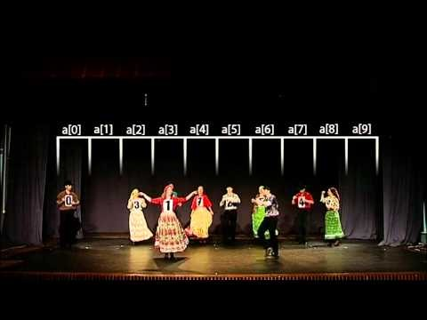
Selection Sort Video
Video from https://www.youtube.com/watch?v=Ns4TPTC8whw

Slide 21
Bubble Sort

Slide 22
Bubble Sort Algorithm
Let’s take a look at another sorting method!
We look at the first pair of items in the list, and if the first one is bigger than the second one, we swap them
Then we look at the second and third one and put them in order, and so on
Once we hit the end of the list, we start over at the beginning
Repeat until the list is sorted!

Slide 23
Bubble Sort Example
[ 4, 8, 1, 10, 13, 14, 6]
First pass:
4 and 8 are in order
8 and 1 should be swapped:
[ 4, 1, 8, 10, 13, 14, 6]
8 and 10 are in order
10 and 13 are in order
13 and 14 are in order
6 and 14 should be swapped:
[ 4, 1, 8, 10, 13, 6, 14]

Slide 24
Bubble Sort Example (Cont)
[ 4, 1, 8, 10, 13, 6, 14]
Second pass:
4 and 1 should be swapped:
[ 1, 4, 8, 10, 13, 6, 14]
4 and 8 are in order
8 and 10 are in order
10 and 13 are in order
13 and 6 should be swapped:
[ 1, 4, 8, 10, 6, 13, 14]
13 and 14 are in order

Slide 25
Bubble Sort Example (Cont)
[ 1, 4, 8, 10, 6, 13, 14]
Third pass:
10 and 6 should be swapped:
[ 1, 4, 8, 6, 10, 13, 14]
Fourth pass:
8 and 6 should be swapped:
[ 1, 4, 6, 8, 10, 13, 14]

Slide 26
Bubble Sort Run Time
For a list of size N, how much work do we do for a single pass?
N
How many passes will we have to do?
N
What is the run time of Bubble Sort?
N²

Slide 27
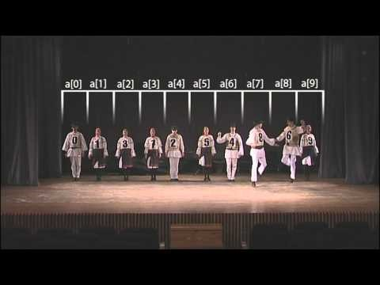
Bubble Sort Video
Video from https://www.youtube.com/watch?v=lyZQPjUT5B4

Slide 28
Quicksort

Slide 29
Quicksort Algorithm
Here’s another method:
Start with the number on the far right
Put everything less than that number on the left of it and everything greater than it on the right of it
Quicksort the left side and the right side
Does this method remind you of anything?

Slide 30
Quicksort Run Time
For a list of size N, how many steps does it take to move everything less than the last number to the left and everything greater than the last number to the right?
N

Slide 31
Quicksort Run Time
How many times will the algorithm divide the list in half?
lg(N)
What is the run time of Quicksort?
N * lg(N)

Slide 32
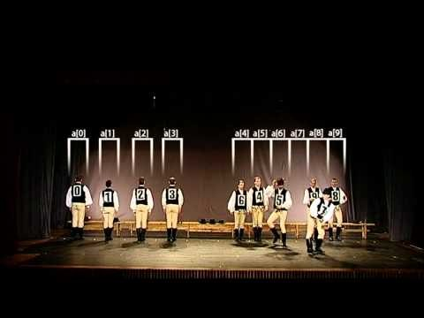
Quicksort Video
Video from https://www.youtube.com/watch?v=ywWBy6J5gz8

Slide 33
Announcements
Final is when?
“Hour of code” volunteer opportunity
http://www.signupgenius.com/go/10c0f45aaab2aabfc1-hour
Project 2 out now
Due on Tuesday, December 13th
Survey #3 also out – follow link in announcement
Thursday, December 15th (3:30 – 5:30)

